Slide 1
Location optimization for establishing a new Chinese restaurant in Toronto
Quan jinji
April 12, 2021

Slide 2
Contents
1.Introduction
Background
Problem
Interest
2.Data acquisition and cleaning
Data sources
Data cleaning
3. Methodology
Geocoding API and Foursquare API
Data Visualization
Clustering
4. Results
5. Discussion
6.Conclusion

Slide 3
Introduction
Background
Toronto is the capital city of the Canadian province of Ontario. With a recorded population of 2,731,571,it is the most populous city in Canada and the fourth most populous city in North America. There are 299,460 Chinese People live in City of Toronto. Which makes 11.1% of the total population. Also the Chinese population has a tendency to grow continuously. Thus, It is a big business opportunity for a Chinese restauranteur to open a Chinese restaurant in the city of Toronto.

Slide 4
Introduction
Problem
The problem I want to solve is to help a Chinese restauranteur to find a optimal place in city of Toronto for establishing his restaurant. As a invester, It is always important to find a place where has the lowest risk and highest probability of success. In this project, I will scan throughout the Toronto neighborhood, classify the areas with the Chinese population,number of restaurants，median income.
Interest
This project is targeted to investors who would like to establish a new Chinese restaurant in city of Toronto.

Slide 5
Data Sources
1.City of Toronto Neighbourhood Profiles https://open.toronto.ca/dataset/neighbourhood-profiles/
2.Latitude and longitude of neighborhood in Toronto can be gotten through usage of python library Geocoder. Refer to the following link for more information. https://geocoder.readthedocs.io/
3.Foursquare API to explore the famous venues especially Chinese restaurant in the neighborhood of Toronto. One will need to register his developer account from the following URL in order to access to Foursquare API. https://developer.foursquare.com/

Slide 6
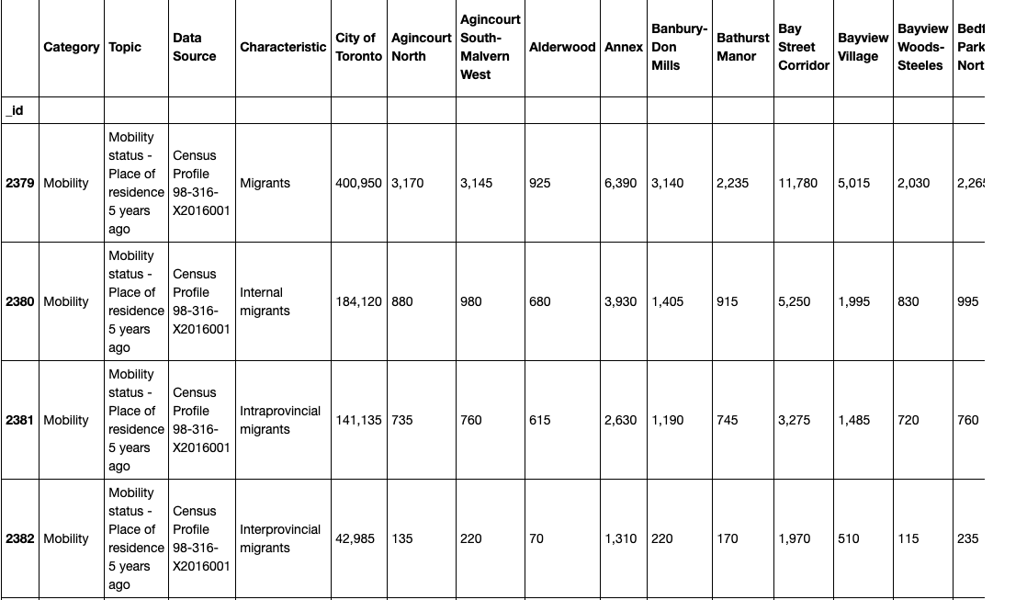
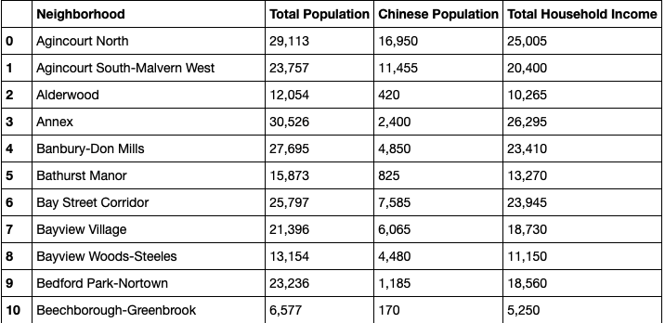
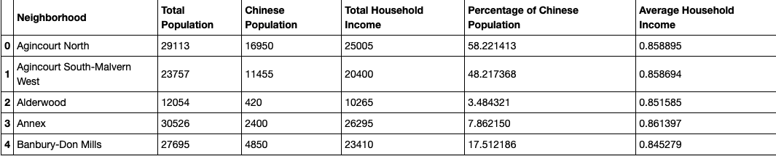
Data cleaning

Slide 7
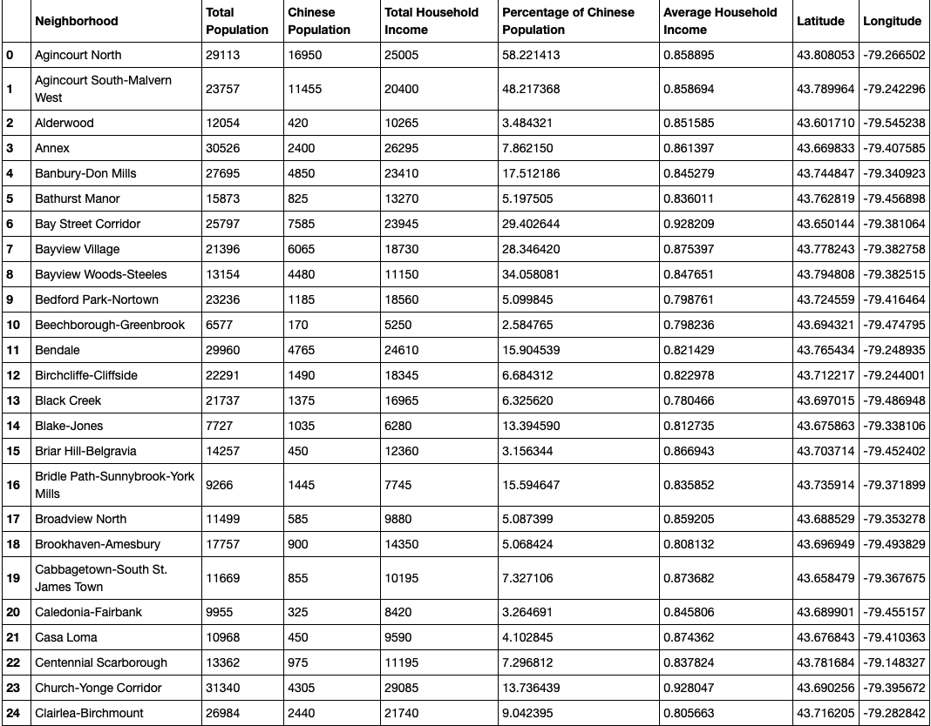
Methodology
Geocoding API
Using Geocoding API to get
the Neighborhoods’
latitude and longitude.
Insert into the Dataframe.

Slide 8
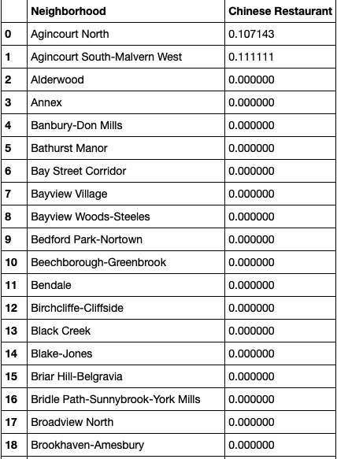
Methodology
Foursquare API
With the Foursquare API we can
also retrieve all the venues in each
Neighborhoods.
We are going to only focus on the
Chinese Restaurants.

Slide 9
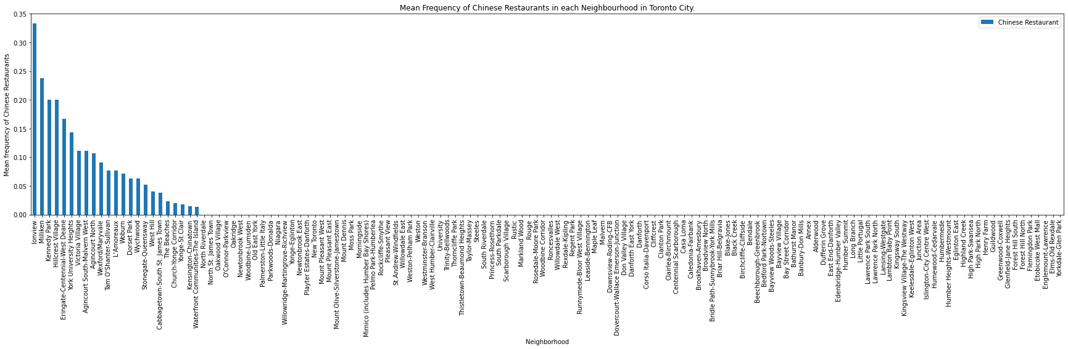
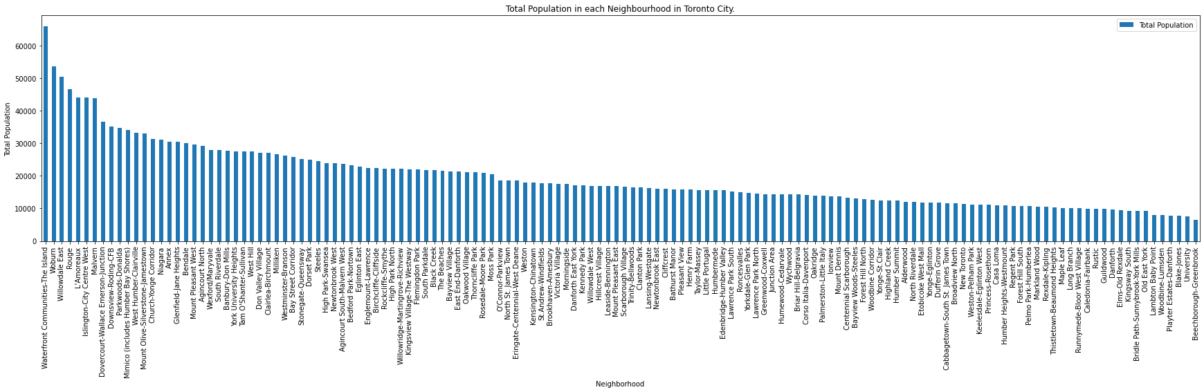
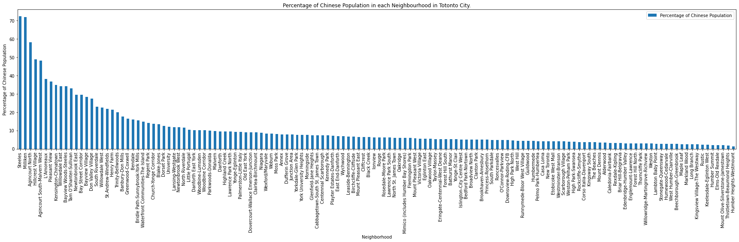
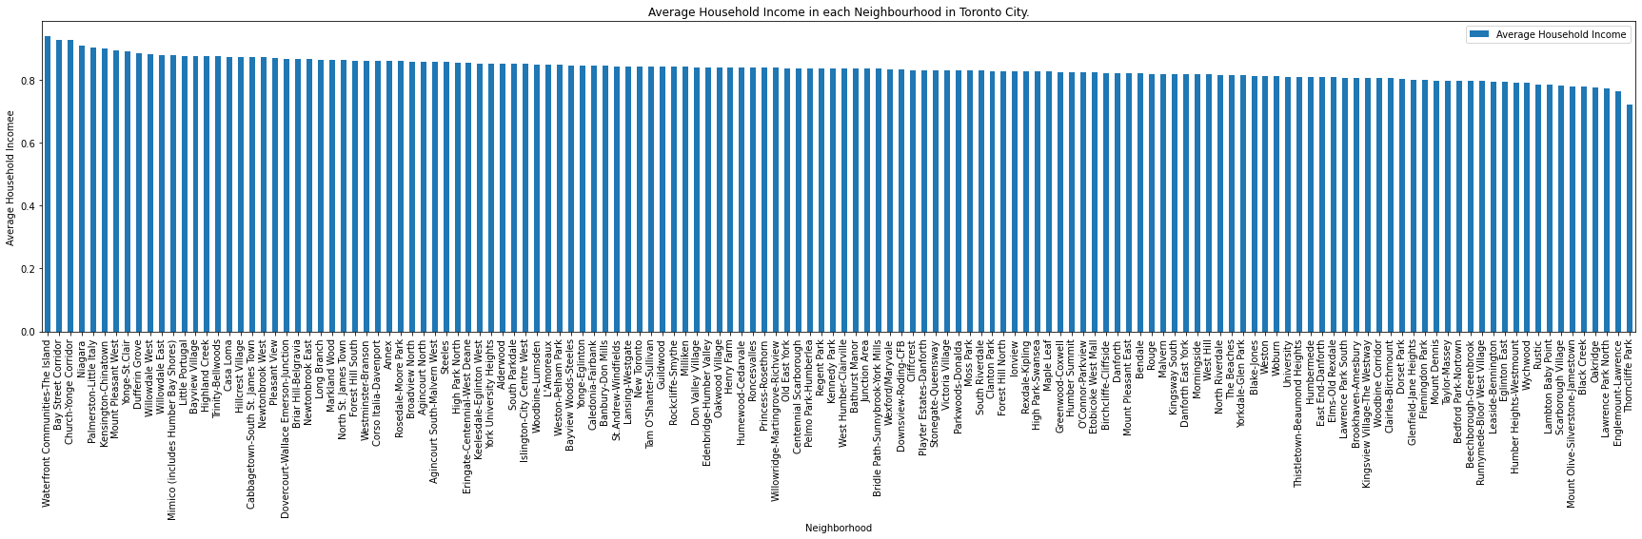
Data Visualization
Bar Chart

Slide 10
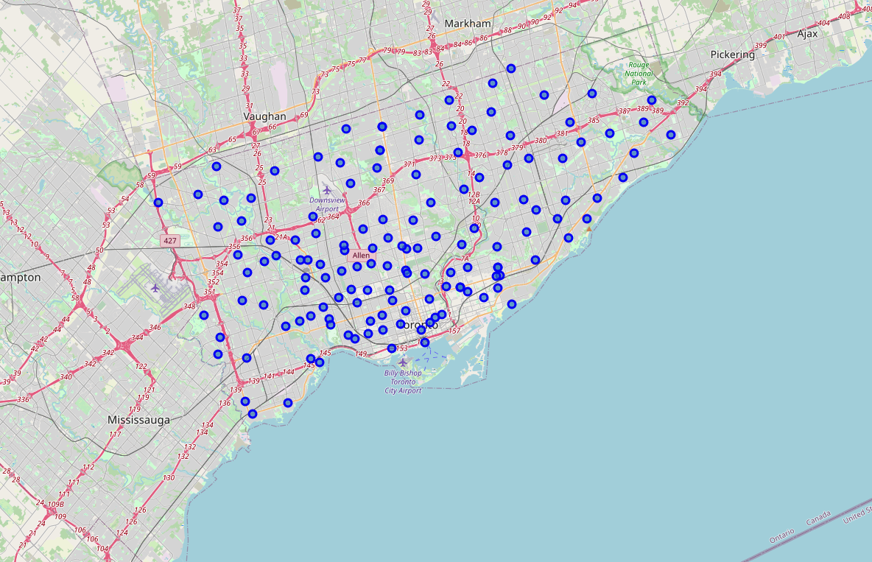
Data Visualization
Folium

Slide 11
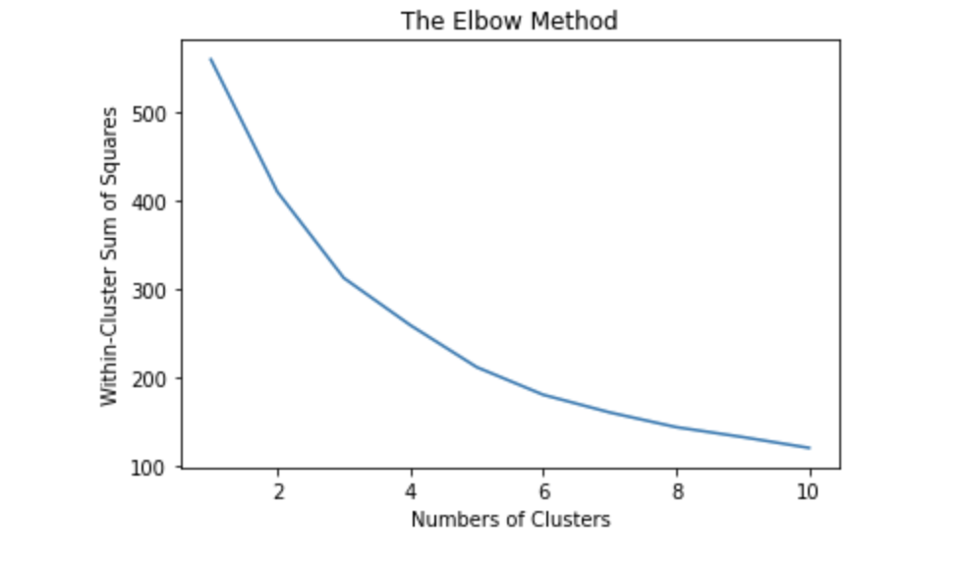
Clustering
The first step is Feature Scaling for independent variables.
Then use K-means clustering algorithm, as the picture shows, the best k is 5.

Slide 12
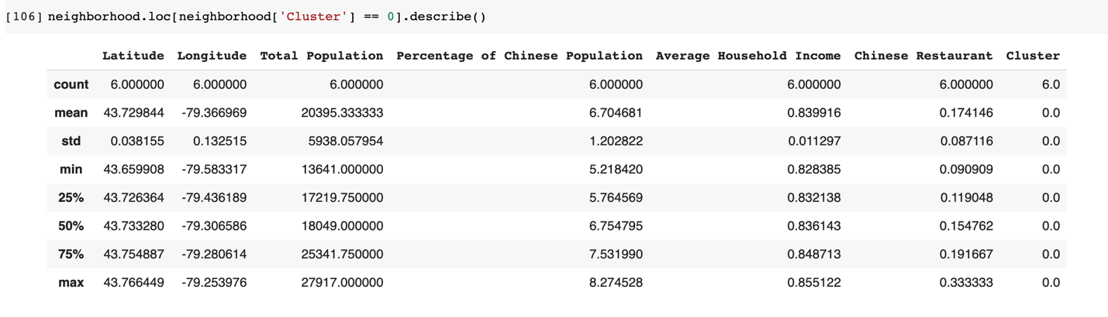
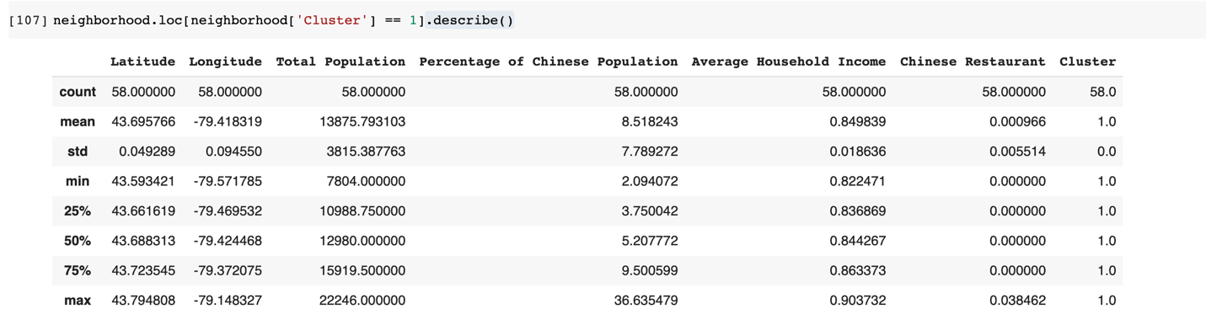
Results
The Neighborhoods are separated into 5 cluster groups shown below.

Slide 13
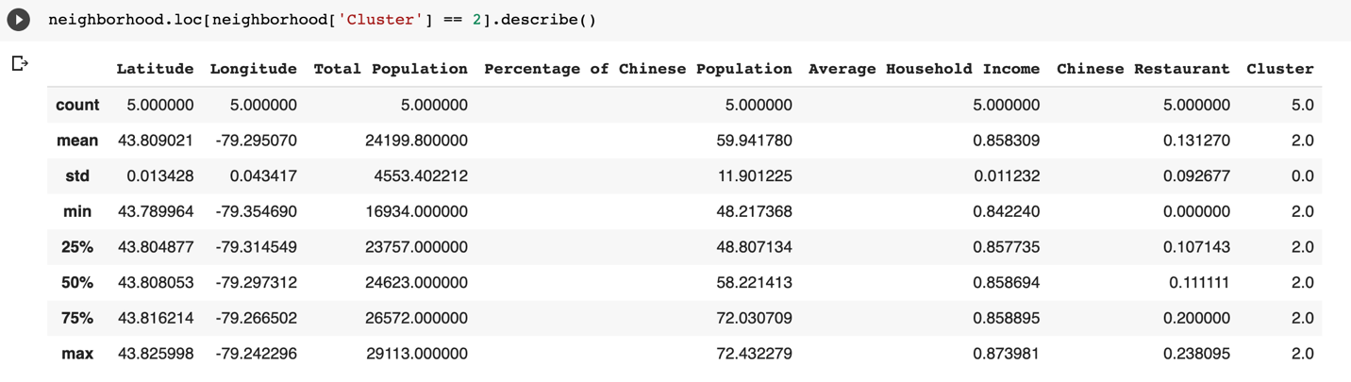
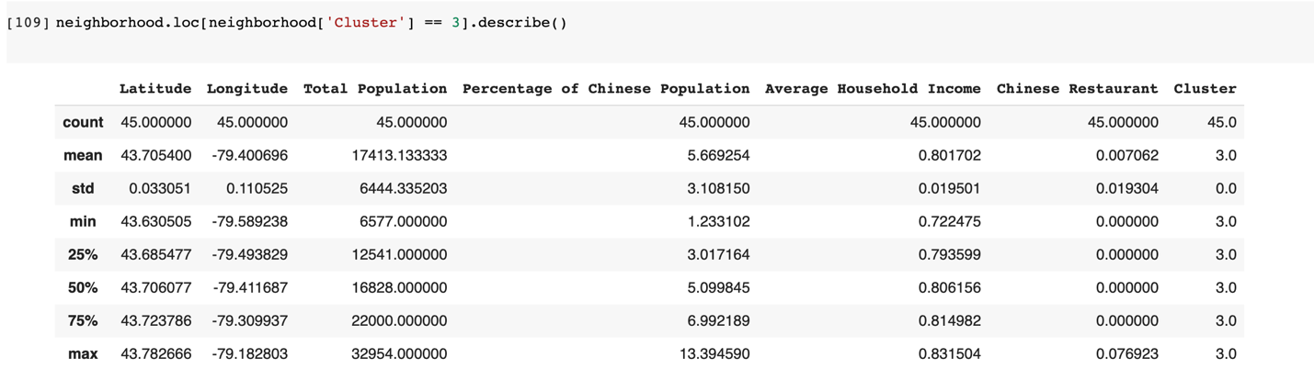
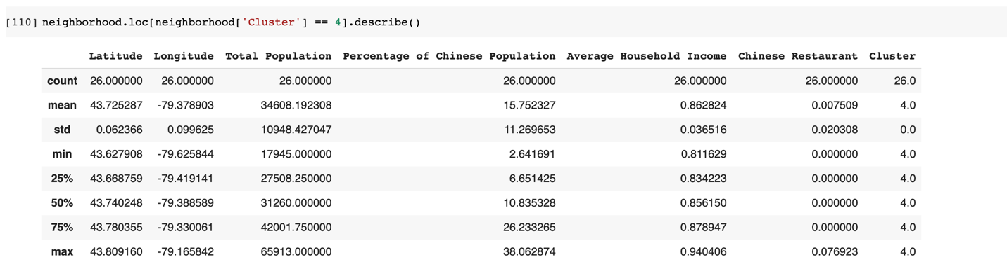

Slide 14
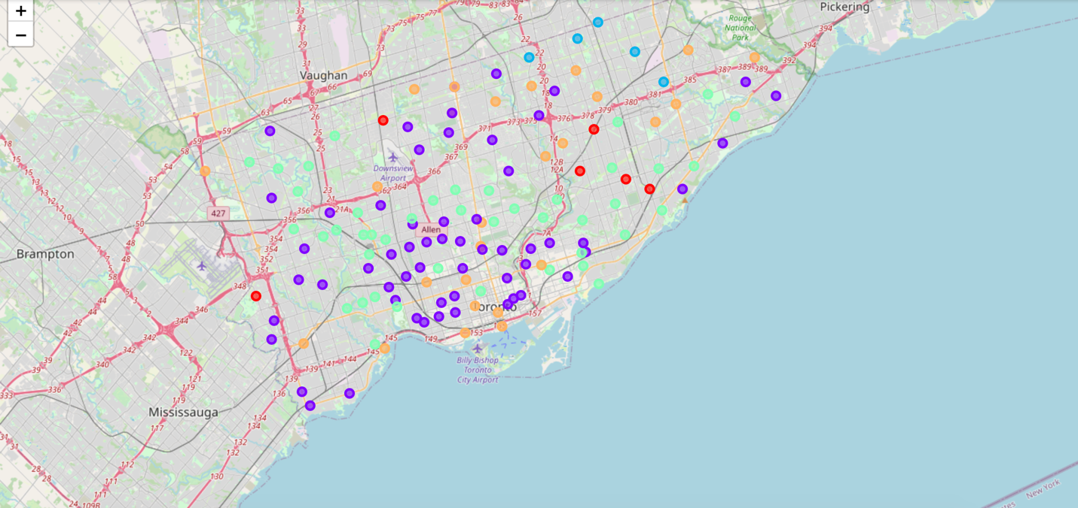
Results
By using Folium, a map showing Toronto City can be generated with different cluster indicated by different colors.

Slide 15
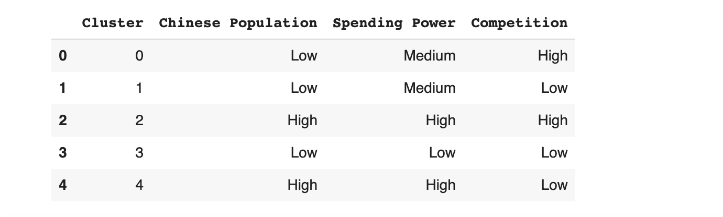
Discussion
The analysis above is summarized in a table below.
For leading business to success:
Chinese Population ↑
Spending Power ↑
Competition ↓

Slide 16
Conclusion
As a result, cluster 4 is to be prioritized by the invester who is going to eastablish a Chinese Restaurant in Toronto City.
Accoring to the Map, north-east and south are the best place in Toronto to start a new Chinese Restaurant.

